Slide 1
COVID-19 Data Analysis
Insights from Infection Rates, Deaths, and Vaccination Efforts Across Continents

Slide 2
Contents
Problem Statement
Data Collection
Data Preprocessing
Exploratory Data Analysis
Data Visualization

Slide 3
Problem Statement
The objective of this project is to analyze the global spread of COVID-19, including infection rates, death counts, and vaccination efforts, and to correlate these with various socio-economic indicators such as the Human Development Index (HDI)

Slide 4
Data Collection
The data is acquired from an open data source (COVID-19 Data).
It consists of 67 columns and 280K rows.
The dataset is downloaded in csv format.

Slide 5
Data Preprocessing
The dataset is divided into two different files - COVID Deaths and COVID Vaccinations.
The two files are exported into PostgreSQL database as tables.

Slide 6
Exploratory Data Analysis
Exploratory data analysis is performed on the COVID-19 using SQL in a PostgreSQL database.

Slide 7
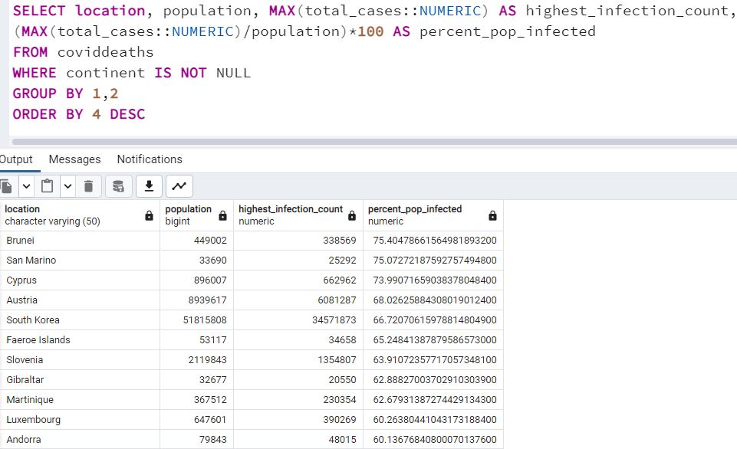
Country-wise Infection Count

Slide 8
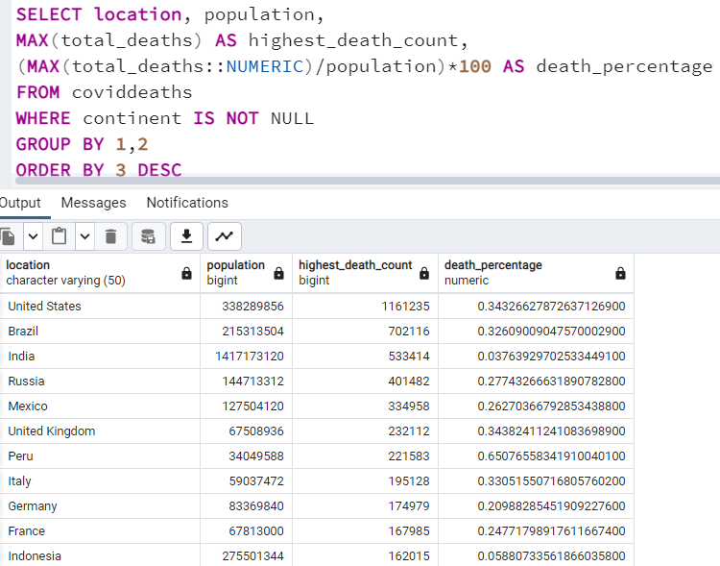
Country-wise Highest Death Count

Slide 9
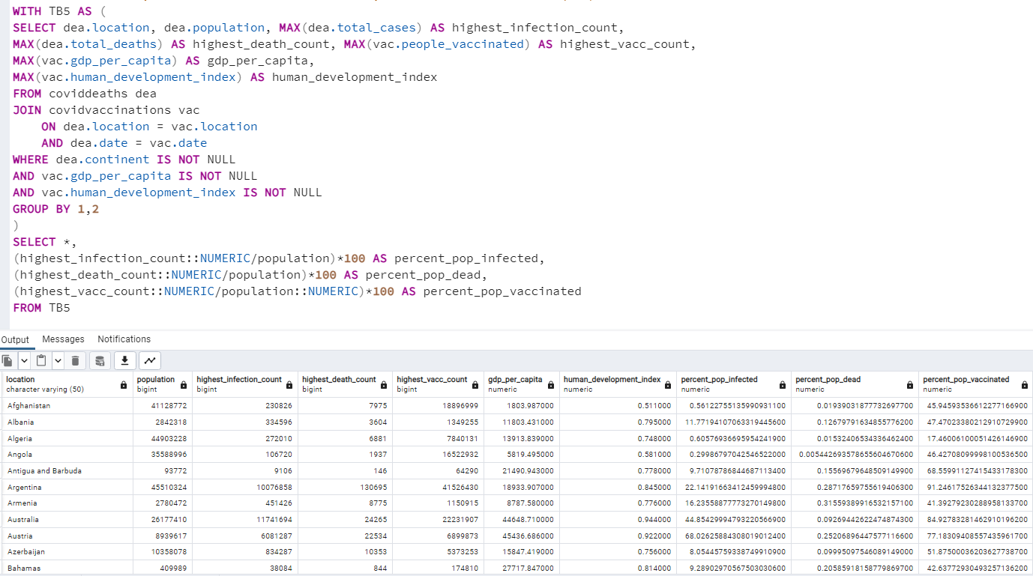
Infections and Deaths Vs GDP Per Capita and HDI

Slide 10
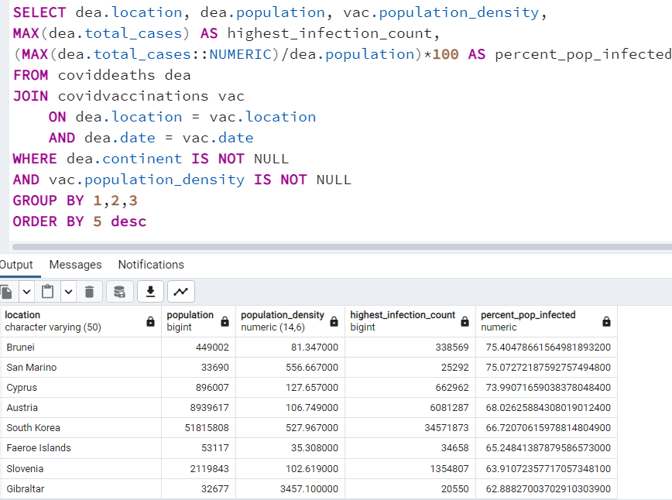
Infected Population Vs Population Density

Slide 11
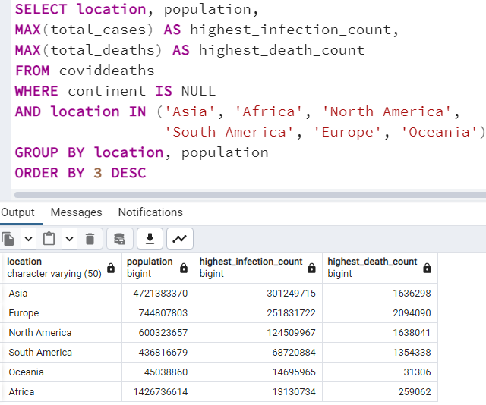
Global Numbers

Slide 12
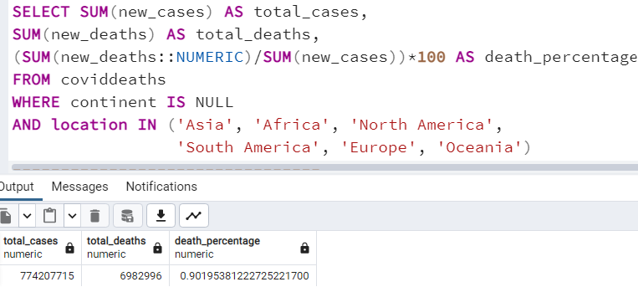
Total Numbers

Slide 13
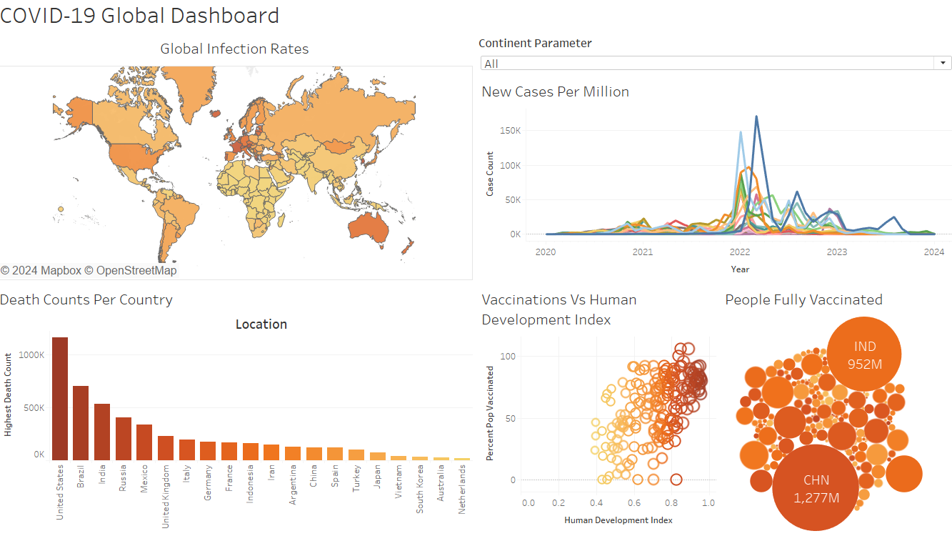
Data Visualization

